Slide 1
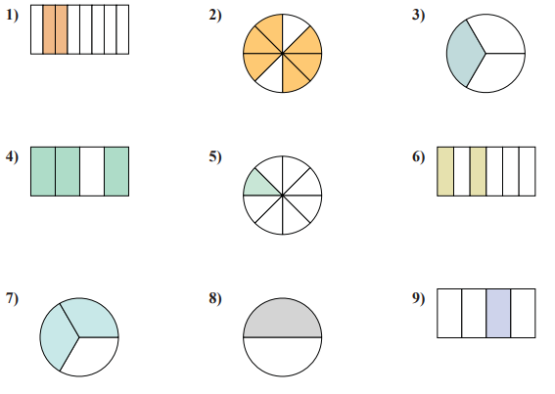
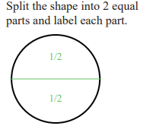
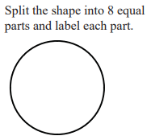
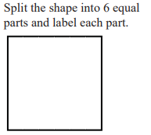
Fractions Homework – 1 Name __________________________________
Due ____________________________________
Beside each shape, write the shaded amount as a fraction .
Partition each shape into the amount shown below and label each unit fraction. An example is shown below.
10) 11)
12)

Slide 2
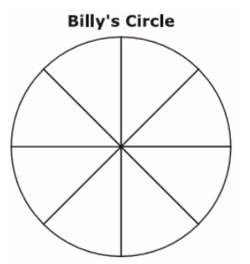
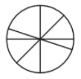
13) Use the information provided to answer part A & B.
A vegetable garden is divided into 8 equal parts. The kinds of vegetables planted in the garden are shown below.
Part A
What part of the garden is planted with peas? Circle your answer below.
$\frac{1}{8}$ $\frac{1}{4}$ $\frac{2}{8}$ $\frac{2}{6}$
Part B
What part of the garden is planted with carrots? Circle your answer below.
$\frac{1}{8}$ $\frac{1}{4}$ $\frac{2}{4}$ $\frac{2}{6}$
14) Billy drew the circle below and partitioned it into equal parts.
Which fraction does each piece represent?
$\frac{1}{8}$ $\frac{1}{4}$ $8 1$
15) Sandi draws a shape. She divides it into parts. Each part is $\frac{1}{8}$ of the shape. Which of the following shapes could Sandi have drawn? Circle your answer below.

